Slide 1
Qualitative Tracking of Objects in a Smart Home
Frédéric Bergeron Kevin bouchard
Sébastien Gaboury Sylvain Giroux
Bruno Bouchard

Slide 2
Plan
Context
Goal
Indoor Positioning System
Indoor Tracking System
What’s next

Slide 3
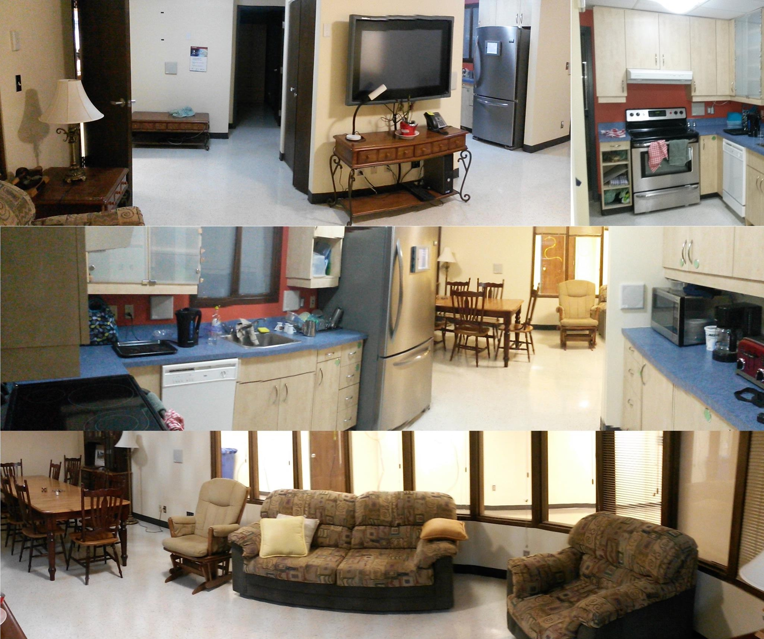
Context
It is predicted that health care costs will continue to grow at a faster rate than the economy for the next decades
Assistive smart home to enable aging in place
Notes:
Population is ageing in occidental countries
It’s a big pressure on health care systems.
United Nation predicts that health care related cost will continue to grow faster than economy for the next decades
A solution is to build housing equiped with different kind of sensors, called smart home, to enable elder to age at home, in a safe and assitive environment
Next slide for domus

Slide 4
Context – DOMUS
Domus is a research laboratory on computer science specialized in smart home and cognitive assistance for people with cognitive deficits.
- Full scale smart home
  6 rooms
  Dozens of sensors
  20 RFID antennas
Notes:
The work I present today took place in the DOMUS laboratory. We specialize on using computer science and a smart home to provide cognitive assistance and monitoring for people in need, like those suffering from Alzheimer’s disease or traumatic brain injury
In the lab, we have a full scale smart home with dozen of sensors, like motion detector, pressure plate, thermal camera, microphones and so on
Not to forget 20 RFID antennas, used in this experiment

Slide 5
Goal
Final goal ➔ Activities of daily living recognition
Indoor positioning system (IPS)
Indoor tracking system (ITS)
ADL recognition
Notes:
The goal of my master thesis is to use RFID to recognise activities of daily living, using data mining techniques. This will later be used in my lab as part of many specialized moniting system.
ADL recognition has been achieved with great accuracy in recent years, with many different technologies
But never with RFID and data mining and relative positioning
Another great difference from previous techniques is
We don’t want to track human, we believe we can do ADL recognition only with objects
To do the actual recognition, I first needed an ITS, which itself required and IPS.
But before explaining the IPS, …

Slide 6
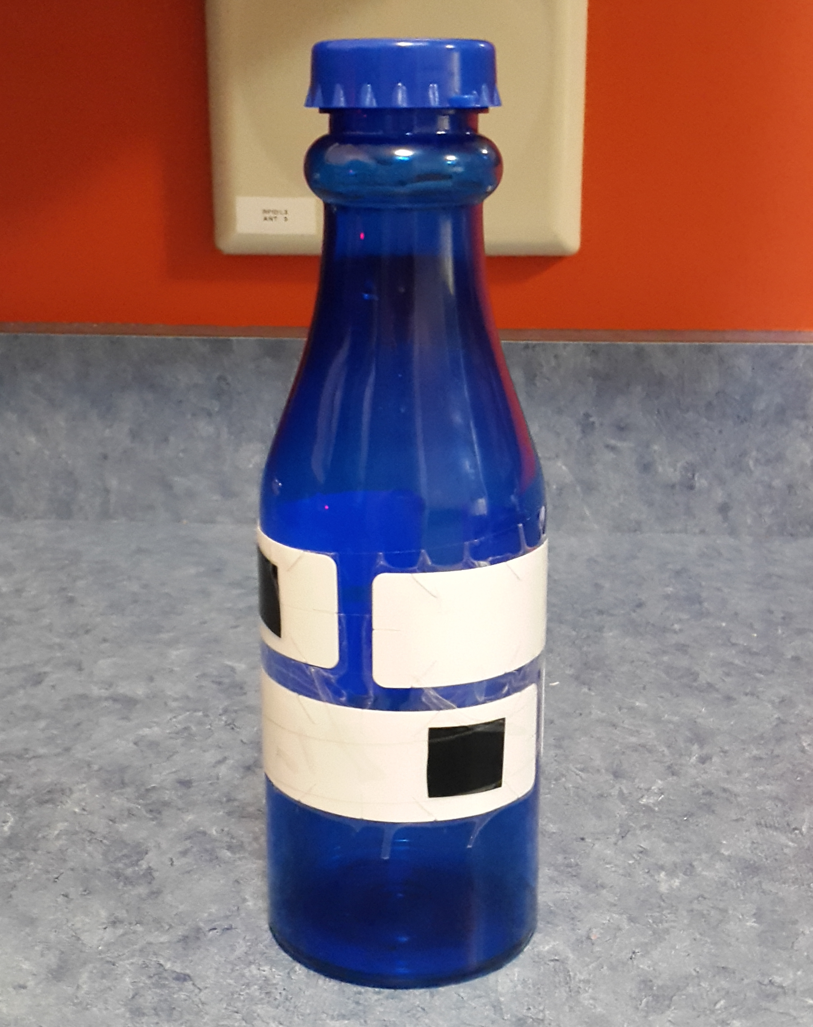
Indoor Positioning System – Tracked Object
Plastic bottle
4 tags
Hold at about 1m high
Notes:
First, for both systems, need a special object to rely on
In plastic to avoid interferences at this early developement stage
4 tags facing different directions
Antennas are at 1 meter high, so is the bottle in our tests
For each tag, we have a reading per antenna, a vector of 20 integers
We merge to 4 tags into one, keeping only the highest value foreach antenna

Slide 7
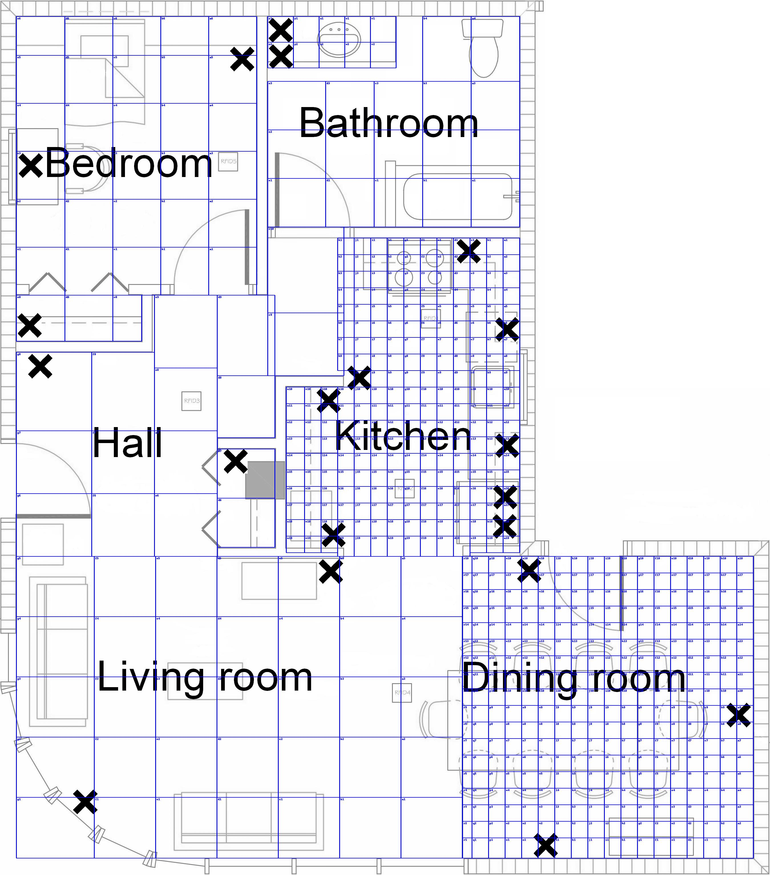
Indoor Positioning System – Zones
20cm x 20cm: kitchen, dining room
60cm x 60cm: bedroom, bathroom
75cm x 75cm: hall, living room
➔ accuracy ranging from 80% to 95%
Notes:
I said I use relative positioning
It means I use zone of different sizes instead of a precise position in coordinate
When building the IPS, dimensions were…
This is an approximative map of the smart home with zones
The big X are my antennas
Using a random forest of 250 trees per room, accuracy range from 80% to 95%

Slide 8
Indoor Tracking System – Dataset
6 rooms
4 paths per room
10 tries per path
240 paths total
Notes:
Now the traking system
As with the IPS, we first designed a dataset to experiment on.
In each room, we created 4 differents paths that were plausible, like taking the bottle from the fridge to the oven.
For each of those 24 path, we collected data 10 times, resulting with 240 paths we can evaluate accuracy on.

Slide 9
Indoor Tracking System – Metrics
Targeted Zones Found (TZF)
  Percentage of zones found
Notes:
To evaluate our accuracy, we needed metrics.

Slide 10
Indoor Tracking System – Metrics
Targeted Zones Found (TZF)
  Percentage of zones found
Sequential Targeted Zones Found (STZF)
  Percentage of zones found in the right order

Slide 11
Indoor Tracking System – Metrics
Targeted Zones Found (TZF)
  Percentage of zones found
Sequential Targeted Zones Found (STZF)
  Percentage of zones found in the right order
Levenshtein distance (L dist)
  Edit distance, number of operations needed to make a sequence equal to another

Slide 12
Indoor Tracking System – Metrics
Targeted Zones Found (TZF)
  Percentage of zones found
Sequential Targeted Zones Found (STZF)
  Percentage of zones found in the right order
Levenshtein distance (L dist)
  Edit distance, number of operations needed to make a sequence equal to another
Euclidiean distance (E dist)
  Split zones found into N segment, take the mean, compute euclidiean distance with the corresponding targeted zone

Slide 13
Indoor Tracking System – Raw results
Metric | TZF | STZF | L dist | E dist
Bedroom | 0,333 | 0,196 | 68,275 | 2,578
Bathroom | 0,589 | 0,311 | 70 | 4,804
Hall | 0,538 | 0,347 | 41,975 | 1,287
Kitchen | 0,372 | 0,179 | 101,225 | 3,353
Living room | 0,591 | 0,327 | 95,525 | 2,325
Dining room | 0,114 | 0,057 | 71,175 | 7,101
Average | 0,423 | 0,236 | 74,696 | 3,575
Notes:
Roughly, sequential is half as good
L dist is not good, not showing much, aside that sequence are really long, around 60 zones more than the path.
Euclidiean distance shows that when TZF fall, distance increase

Slide 14
Indoor Tracking System – Raw results
Metric | TZF | STZF | L dist | E dist
Bedroom | 0,333 | 0,196 | 68,275 | 2,578
Bathroom | 0,589 | 0,311 | 70 | 4,804
Hall | 0,538 | 0,347 | 41,975 | 1,287
Kitchen | 0,372 | 0,179 | 101,225 | 3,353
Living room | 0,591 | 0,327 | 95,525 | 2,325
Dining room | 0,114 | 0,057 | 71,175 | 7,101
Average | 0,423 | 0,236 | 74,696 | 3,575
Notes:
It’s really low in places with small zone, like kitchen and dining room
Next is a video, of what it looks like

Slide 15
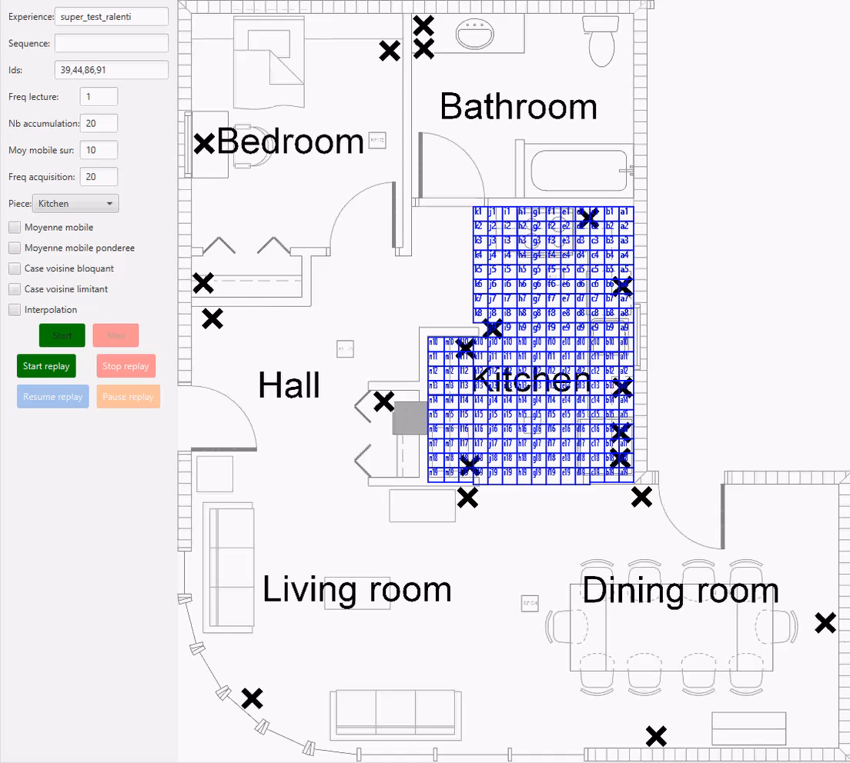
Indoor Tracking System – Raw results
Notes:
So in green we see the real path we followed
When it turns blue, it’s because we correctly identified the zone
As we can see, the object teleport itself everywhere
Really bad
So we hadded filters

Slide 16
Indoor Tracking System – Filters
Moving Average
Notes:
to try to decrease the error rate (and teleportation)
The first one is simply a moving average

Slide 17

Indoor Tracking System – Filters
Moving Average
Weighted moving average
  $$\overline{R}={\sum_{n=0}^{N−1}{C_{n}∗R_{N−n}}}/{\sum_{n=0}^{N−1}{C_{n}}}$$
Notes:
Then the weighted moving average, the generalized form of the previous one

Slide 18

Indoor Tracking System – Filters
Moving Average
Weighted moving average
  $$\overline{R}={\sum_{n=0}^{N−1}{C_{n}∗R_{N−n}}}/{\sum_{n=0}^{N−1}{C_{n}}}$$
Blocking neighbour
  Only allow deplacement if the new zone is a direct neighbour to the old zone
Notes:
So we added filter, to try to decrease the error rate (and teleportation)

Slide 19
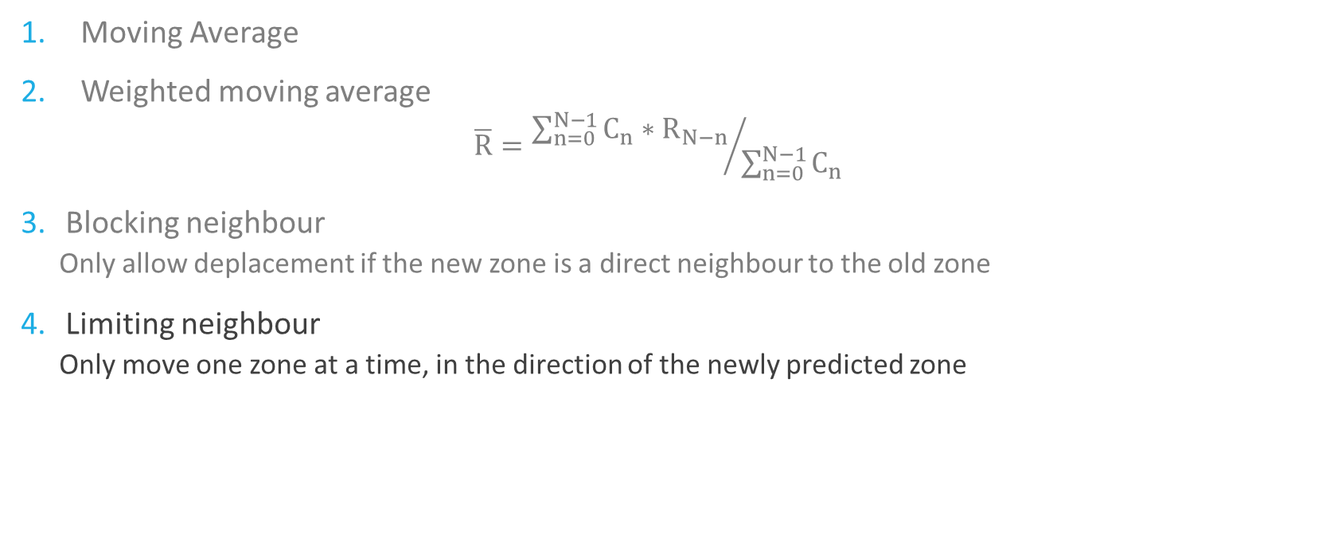
Indoor Tracking System – Filters
Moving Average
Weighted moving average
  $$\overline{R}={\sum_{n=0}^{N−1}{C_{n}∗R_{N−n}}}/{\sum_{n=0}^{N−1}{C_{n}}}$$
Blocking neighbour
  Only allow deplacement if the new zone is a direct neighbour to the old zone
Limiting neighbour
  Only move one zone at a time, in the direction of the newly predicted zone
Notes:
So we added filter, to try to decrease the error rate (and teleportation)

Slide 20
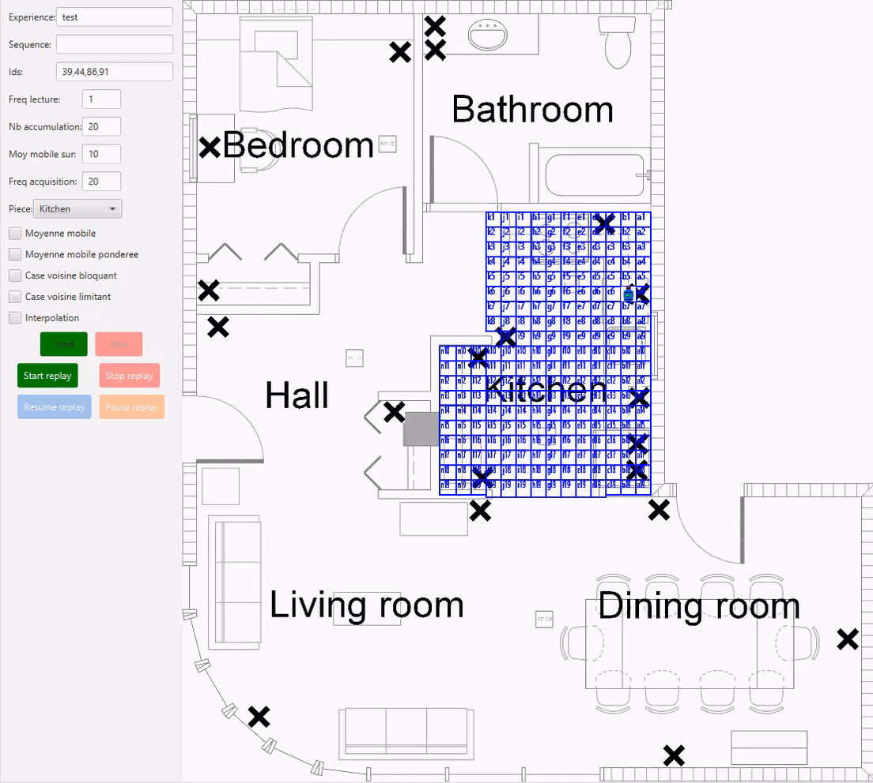
Indoor Tracking System – Moving Average
Notes:
This video shows the effect of the moving average on the stability
The object is at h3, and look it move then stop nobody moves it, it’s a static test
nobody moves it

Slide 21
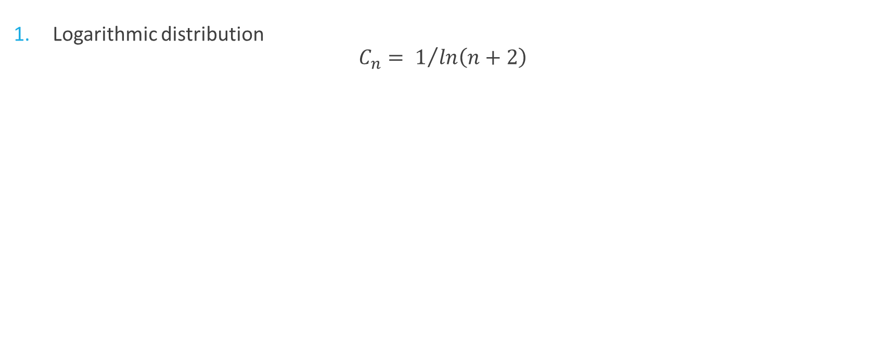
Indoor Tracking System – Weighted Moving Average
Logarithmic distribution
$C_{n}= 1/{ln\left(n+2\right)}$
Notes:
We used 4 distribution for the weighted moving average
We used n+2 to make sure we are in the smooth part of the log function

Slide 22
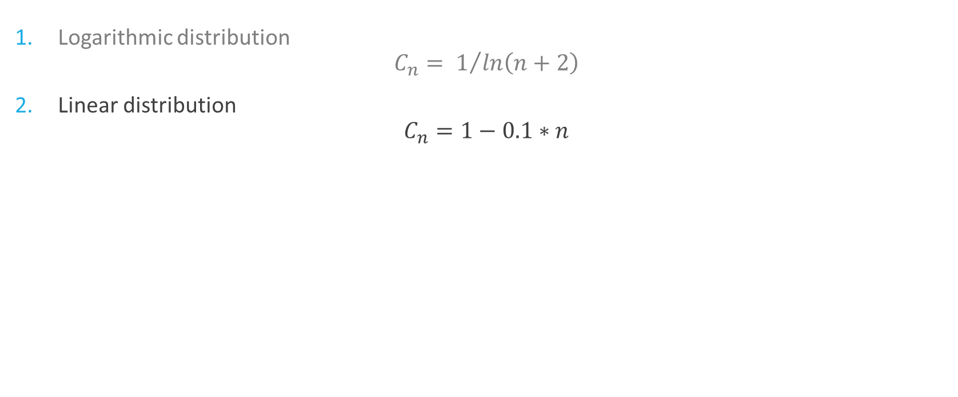
Indoor Tracking System – Weighted Moving Average
Logarithmic distribution
$C_{n}= 1/{ln\left(n+2\right)}$
Linear distribution
$C_{n}=1−0.1∗n$
Notes:
Simple decreasing

Slide 23
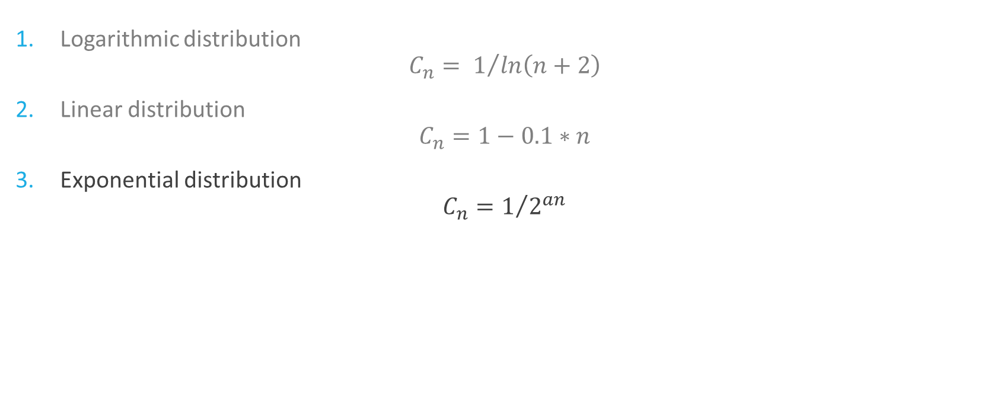
Indoor Tracking System – Weighted Moving Average
Logarithmic distribution
$C_{n}= 1/{ln\left(n+2\right)}$
Linear distribution
$C_{n}=1−0.1∗n$
Exponential distribution
$C_{n}=1/{2^{an}}$
Notes:
We tested different value for the parameter a that I’ll show in the next slide

Slide 24
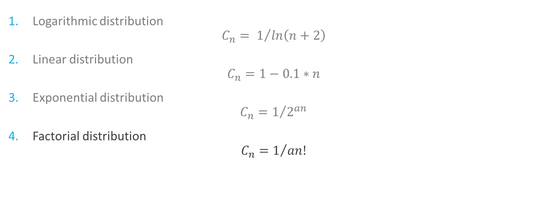
Indoor Tracking System – Weighted Moving Average
Logarithmic distribution
$C_{n}= 1/{ln\left(n+2\right)}$
Linear distribution
$C_{n}=1−0.1∗n$
Exponential distribution
$C_{n}=1/{2^{an}}$
Factorial distribution
$C_{n}=1/{an!}$
Notes:
Once again, many a in the next slide

Slide 25
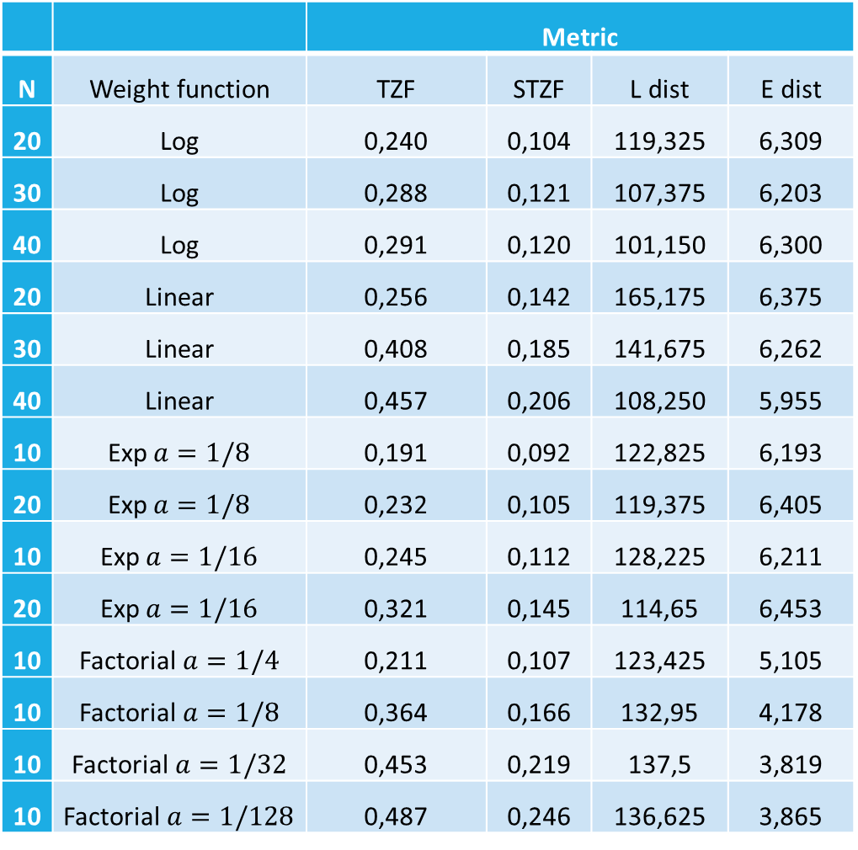
Indoor Tracking System - Results
 |  | Metric
N | Weight function | TZF | STZF | L dist | E dist
20 | Log | 0,240 | 0,104 | 119,325 | 6,309
30 | Log | 0,288 | 0,121 | 107,375 | 6,203
40 | Log | 0,291 | 0,120 | 101,150 | 6,300
20 | Linear | 0,256 | 0,142 | 165,175 | 6,375
30 | Linear | 0,408 | 0,185 | 141,675 | 6,262
40 | Linear | 0,457 | 0,206 | 108,250 | 5,955
10 | Exp$a=1/8$ | 0,191 | 0,092 | 122,825 | 6,193
20 | Exp$a=1/8$ | 0,232 | 0,105 | 119,375 | 6,405
10 | Exp$a=1/16$ | 0,245 | 0,112 | 128,225 | 6,211
20 | Exp$a=1/16$ | 0,321 | 0,145 | 114,65 | 6,453
10 | Factorial $a=1/4$ | 0,211 | 0,107 | 123,425 | 5,105
10 | Factorial$a=1/8$ | 0,364 | 0,166 | 132,95 | 4,178
10 | Factorial$a=1/32$ | 0,453 | 0,219 | 137,5 | 3,819
10 | Factorial$a=1/128$ | 0,487 | 0,246 | 136,625 | 3,865

Slide 26
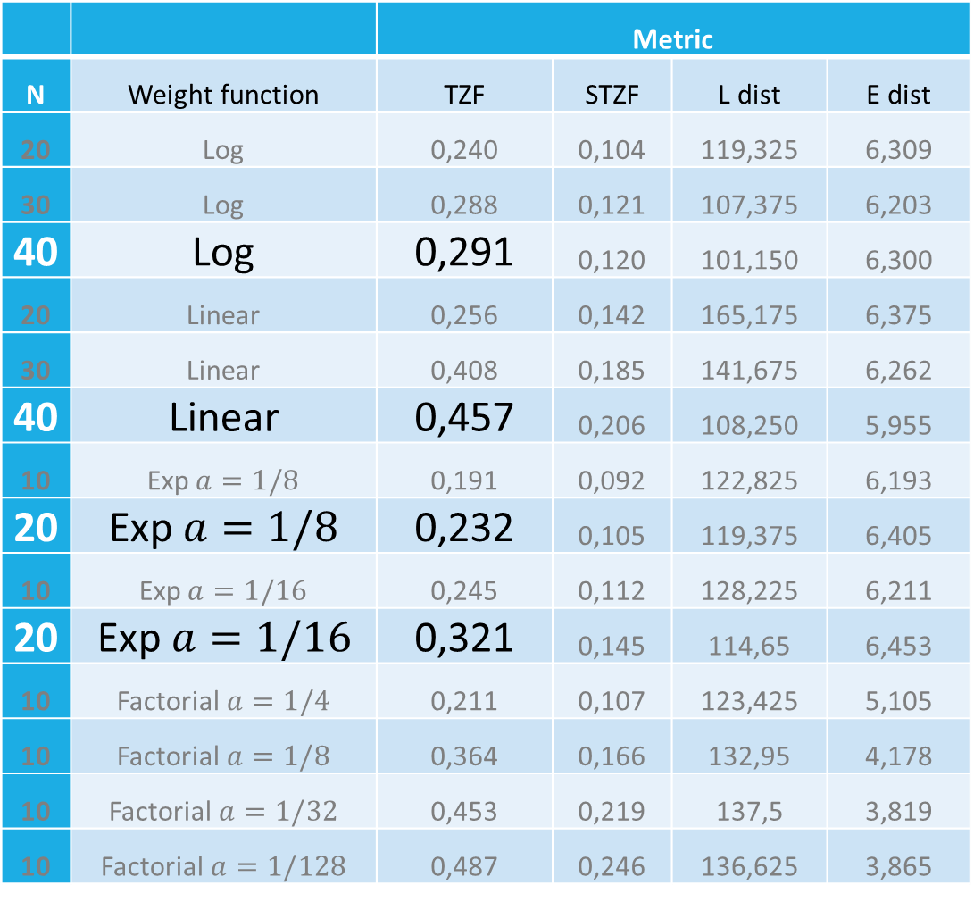
Indoor Tracking System - Results
 |  | Metric
N | Weight function | TZF | STZF | L dist | E dist
20 | Log | 0,240 | 0,104 | 119,325 | 6,309
30 | Log | 0,288 | 0,121 | 107,375 | 6,203
40 | Log | 0,291 | 0,120 | 101,150 | 6,300
20 | Linear | 0,256 | 0,142 | 165,175 | 6,375
30 | Linear | 0,408 | 0,185 | 141,675 | 6,262
40 | Linear | 0,457 | 0,206 | 108,250 | 5,955
10 | Exp$a=1/8$ | 0,191 | 0,092 | 122,825 | 6,193
20 | Exp$a=1/8$ | 0,232 | 0,105 | 119,375 | 6,405
10 | Exp$a=1/16$ | 0,245 | 0,112 | 128,225 | 6,211
20 | Exp$a=1/16$ | 0,321 | 0,145 | 114,65 | 6,453
10 | Factorial $a=1/4$ | 0,211 | 0,107 | 123,425 | 5,105
10 | Factorial$a=1/8$ | 0,364 | 0,166 | 132,95 | 4,178
10 | Factorial$a=1/32$ | 0,453 | 0,219 | 137,5 | 3,819
10 | Factorial$a=1/128$ | 0,487 | 0,246 | 136,625 | 3,865
Notes:
Accuracy increase with n

Slide 27
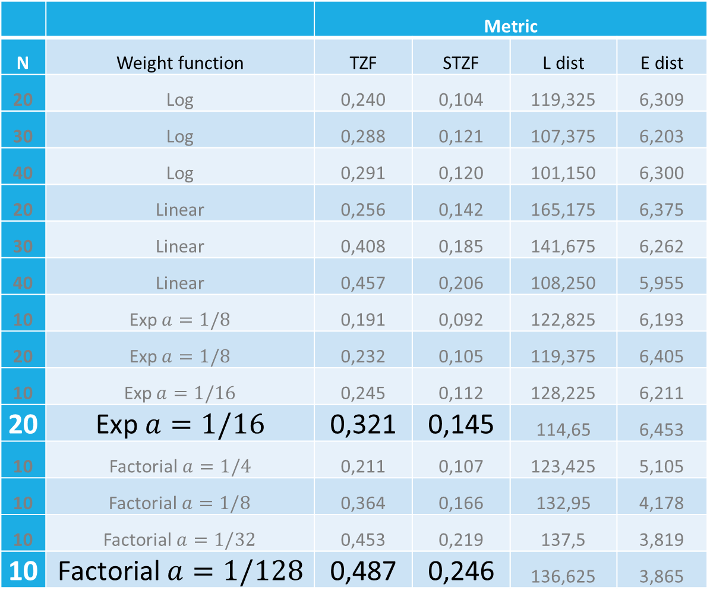
Indoor Tracking System - Results
 |  | Metric
N | Weight function | TZF | STZF | L dist | E dist
20 | Log | 0,240 | 0,104 | 119,325 | 6,309
30 | Log | 0,288 | 0,121 | 107,375 | 6,203
40 | Log | 0,291 | 0,120 | 101,150 | 6,300
20 | Linear | 0,256 | 0,142 | 165,175 | 6,375
30 | Linear | 0,408 | 0,185 | 141,675 | 6,262
40 | Linear | 0,457 | 0,206 | 108,250 | 5,955
10 | Exp$a=1/8$ | 0,191 | 0,092 | 122,825 | 6,193
20 | Exp$a=1/8$ | 0,232 | 0,105 | 119,375 | 6,405
10 | Exp$a=1/16$ | 0,245 | 0,112 | 128,225 | 6,211
20 | Exp$a=1/16$ | 0,321 | 0,145 | 114,65 | 6,453
10 | Factorial $a=1/4$ | 0,211 | 0,107 | 123,425 | 5,105
10 | Factorial$a=1/8$ | 0,364 | 0,166 | 132,95 | 4,178
10 | Factorial$a=1/32$ | 0,453 | 0,219 | 137,5 | 3,819
10 | Factorial$a=1/128$ | 0,487 | 0,246 | 136,625 | 3,865
Notes:
more smooth it is, better it is

Slide 28
Indoor Tracking System – Limiting Filter
 | Metric
Room | TZF | STZF | L dist | E dist
Bedroom | 0,797 | 0,653 | 124,775 | 2,297
Bathroom | 0,886 | 0,660 | 236,350 | 5,732
Hall | 0,814 | 0,711 | 64,800 | 1,218
Kitchen | 0,863 | 0,567 | 248,500 | 3,720
Living room | 0,913 | 0,753 | 207,250 | 2,143
Dining room | 0,496 | 0,233 | 236,400 | 6,696
Average | 0,795 (+0,372) | 0,596 (+0,360) | 186,346 (+111,650) | 3,634(+0,059)
Notes:
This table show how greatly the limiting filter increase accuracy.
L dist is bigger because we cross numerous zones that we did not really go but the filter makes it look like we did

Slide 29

Indoor Tracking System – Limiting Filter

Slide 30
What’s next
Increase the IPS accuracy
  By increasing zones sizes in the kitchen and the dining room
Increase the ITS accuracy
  With new filters
Use the ITS for ADL recognition
Notes:
Increase zone size, we did, it works great
New filter, we are open to suggestion, but keep in mind we want to do real time tracking

Slide 31



Thanks for listening
Questions?

