Slide 1



Indoor Positioning System for Smart Homes based on Decision Trees and Passive RFID
PAKDD 2016
By Frédéric Bergeron¹, Kevin Bouchard¹, Sylvain Giroux¹, Sébastien Gaboury² and Bruno Bouchard²
¹Université de Sherbrooke ²Université du Québec à Chicoutimi

Slide 2
Overview
Introduction
Experiment
Results
Conclusion

Slide 3
Introduction – Indoor localisation
GPS
Video cameras
Microphones
Ultrasonic waves
Electromagnetic waves
  Wi-Fi
  Bluetooth
  RFID

Slide 4
Introduction – RFID
Why RFID?
  Active vs passive
  Cheap
  Small
Why not RFID?
  Difference between 2 consecutive readings
  Difference between 2 tag
  Interference between tags and antennas
  Interference with the environment

Slide 5
Introduction – Existing approaches
Mathematical models
  Triangulation (Angle of arrival based)
  Trilateration (Distance based) D. Fortin-Simard, K. Bouchard, S. Gaboury, B. Bouchard, and A. Bouzouane. Accurate passive rd localization system for smart homes. In Networked Embedded Systems for Every Application (NESEA), 2012 IEEE 3rd International Conference on, pages 1{8. IEEE, 2012.
Reference tags (LANDMARC) L. M. Ni, Y. Liu, Y. C. Lau, and A. P. Patil. Landmarc: indoor location sensing using active rd. Wireless networks, 10(6):701{710, 2004.
Carryon transmitter to track inhabitants

Slide 6
Introduction – Problems
Problems with existing methods
  Precision vs accuracy
  Environment dependent
  Heavy mathematical models
We want an easy to deploy solution to track common objects!

Slide 7
Experiment
Can we do it with data mining?
  Of course!
With which classifier?
  Let’s try the popular ones
    Decision trees
    Decision trees with model on leaves
    Random forest
    k-NN
    Bayesian network
    Neural network
Is anyone better?
  No spoiler!

Slide 8
Experiment - Dataset
Collect using a plastic bottle with four tags on it
Relative positioning → Divide the apartment into zones
Record 50 readings in each zone
  About 50 000 labelled readings available on www.Kevin-Bouchard.com

Slide 9
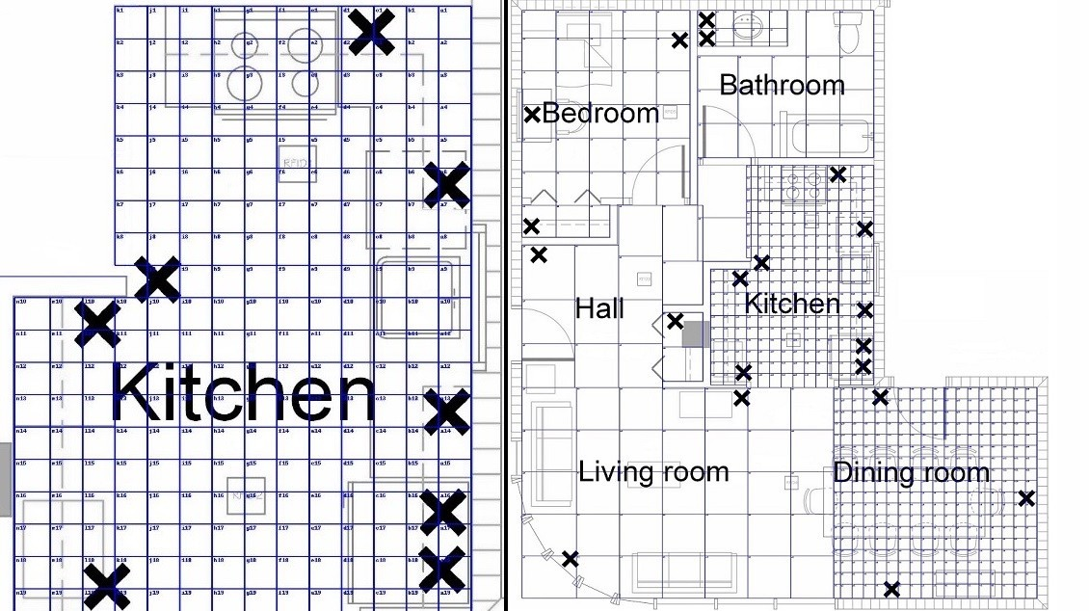
Experiment – Zones
Notes:
Kitchen dining room : 20 cm
Living room / hall 75 cm
Bedroom / Bathroom 60cm
Counter 30cm

Slide 10
Results - Trees
Dataset | Accuracy
 | SimpleCart | J48 | J48graft | Random Tree
Hall | 95,6250 | 96,8750 | 96,6250 | 95,6250
Living Room | 92,4000 | 92,0571 | 92,4571 | 89,3143
Kitchen | 73,4034 | 74,9664 | 75,2353 | 67,8151
Dining Room | 72,4915 | 73,3745 | 73,4548 | 71,0837
Bedroom | 91,5152 | 92,8485 | 92,8485 | 89,8182
Bathroom | 90,2663 | 91,6296 | 91,7777 | 88,1481
Average | 85,9502 | 86,9585 | 87,0664 | 83,6341
Notes:
10 fold cross-validation, as set by default
J48 graft: same as J48, but with add node as a post-precessing step

Slide 11
Results – Trees with model
Dataset | Accuracy
 | Functional Tree | Naive Bayes Tree | Logistic Model Tree
Hall | 95,3750 | 96,3750 | 95,5000
Living Room | 93,0286 | 94,6857 | 93,3143
Kitchen | 73,9076 | 83,2269 | 74,9076
Dining Room | 72,6027 | 73,5783 | 70,3921
Bedroom | 92,7879 | 92,4848 | 92,4242
Bathroom | 91,7037 | 90,9630 | 92,5926
Average | 86,5676 | 88,5523 | 86,5218
Notes:
Functional Tree FT in Table 1, is a normal tree with logistic regression functions at inner nodes or leaves or both, as in our experiment.
NBTree [23] is another tree with the main characteristic that there is naive Bayes classifiers on the leaves
Logistic Model Tree LMT in table 1, looks like the FT in the way that there is logistic regression functions at the leaves. It produces bigger trees than FT, thus being longer to train for similar accuracy.

Slide 12
Results – Other models
Dataset | Accuracy
 | Bayes Net | Neural Net | 1-NN | Random Forest
Hall | 96,3750 | 51,1250 | 94,8750 | 97,7500
Living Room | 97,6571 | 91,2571 | 94,8000 | 97,6000
Kitchen | 84,9832 | 75,6387 | 78,8235 | 88,9160
Dining Room | 74,9305 | 65,2053 | 73,2510 | 76,7274
Bedroom | 95,6970 | 86,4848 | 93,2121 | 96,4848
Bathroom | 95,1111 | 87,4815 | 90,3704 | 96,0741
Average | 90,7923 | 76,1987 | 87,5553 | 92,2587
Notes:
100 tree in random forest

Slide 13
Conclusion
It is possible do achieve great accuracy in indoor positioning with RFID
Using only default parameters from Weka, the best models are:
  Bayesian Network
  1-Nearest Neighbor
  J48
  Random forest
We choose the random forest as the best algorithm on our data
  Fast to train
  Fast to use
  Memory friendly

Slide 14
Future work
Find a way to facilitate data collection
Robustness to human interference
Use the system for continuous tracking of multiple objects in real-time
Activity of daily living recognition

Slide 15
Questions?
Thank you!

