Slide 1
BMP: A Bounded Message Protocol for the IoT
Authors: F. Bergeron, K. Bouchard, S.Gaboury, S.Giroux
presented by Kevin bouchard

Slide 2
Outline
Context
Caracteristics
Workflow
Example of use case

Slide 3
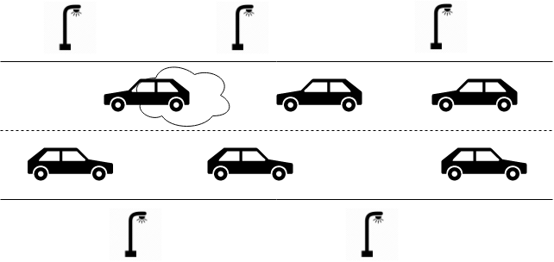
Context
Ah hoc communications
Fluid data
Quantity of data
Notes:
Iot means a lot of object communicating. Creates a problem of identifying usefull data.
Objects are also moving, sometimes fast. When we want to communicate with our neighbors, it is not important who they are and what is their addresse. We just want to send them a message

Slide 4
Caracteristics
No formal routing, no individual addresses
Distance limited propagation
By measurable distance (in meters)
By conceptual distance (a name of a place)
Timed expiration of messages
Time to live
Time of expiration
Broadcasting
Rule-based systems
Notes:
Everything is a broadcast
Messages are general information that might benefit many.
The sender decides what is the range and the time to live.
Time to live is intented to be the time until the next value will be sent
A conceptual distance is more meaningful in a smart home, where spheric distance does not make sense. It is like a topic in publish-subscribe systems
It is intended for rule-based systems. They need more to know what is happening than who sends what

Slide 5
Workflow

Slide 6
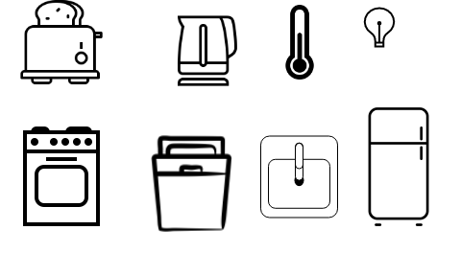
Example
Smart kitchen
Appliances communicate and synchronises themselves
An ambiant agent maintains comfort using diverse sensors

Slide 7
Thanks

